Slide 1

Beginner Workshop 1:
Machine Learning fundamentals and
Linear Regression

Slide 2
OVERVIEW
Key concept: function approximation
Introduction to loss functions
Brief calculus recap: derivatives
Linear regression with gradient descent
Jupyter notebook demo

Slide 3
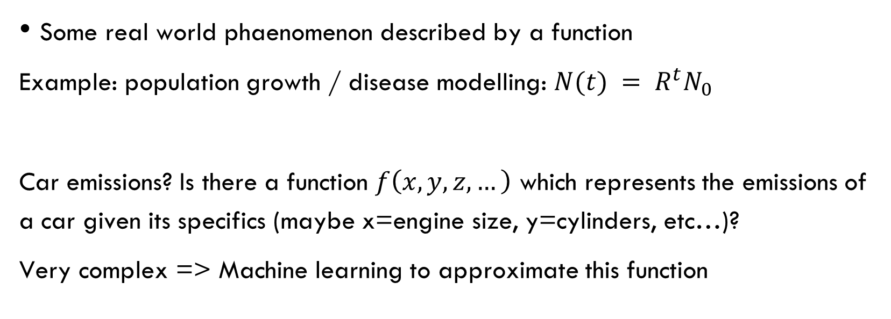
1. What are we even trying to do?
Some real world phaenomenon described by a function
Example: population growth / disease modelling: $N(t) = R^{t}N_{0}$
Car emissions? Is there a function $f\left(x,y,z,…\right)$ which represents the emissions of a car given its specifics (maybe x=engine size, y=cylinders, etc…)?
Very complex => Machine learning to approximate this function

Slide 4
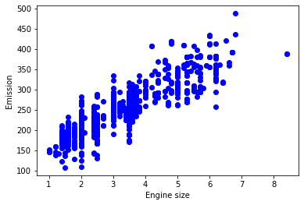


1. What are we even trying to do?
We are looking for a function $\tilde{f}≈f$, but:
We don’t know the inputs to this function (is what colour am I wearing an input?)
We can’t predict intrinsic randomness in real world phaenomena ($ε$)
Hypothesis: $\tilde{f}=\tilde{f}\left(engine size\right)$

Slide 5
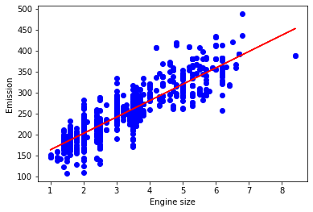

1. What are we even trying to do?
Hypothesis: $\tilde{f}=\tilde{f}\left(engine size\right)$
Curve that best approximates the data

Slide 6
1. What are we even trying to do?
But how do we find such a curve that matches human intuition?
And how do we know that, once we decided we want a straight line, it’ll be the best fitting one among all lines?

Slide 7
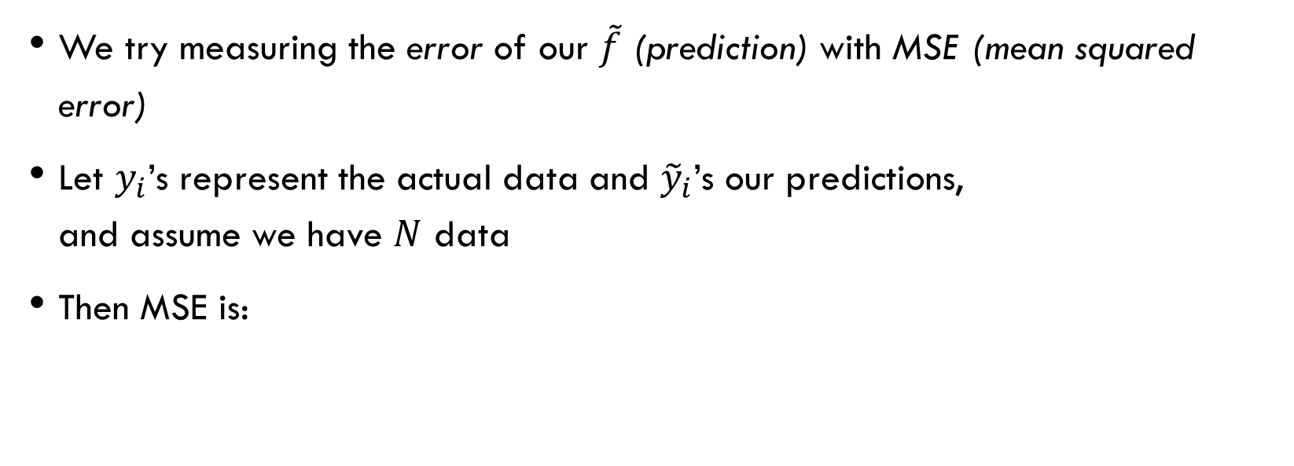
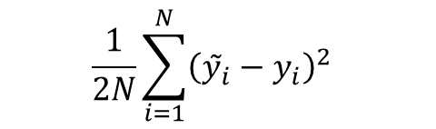
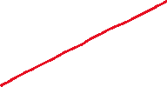
2. Introduction to loss functions
We try measuring the error of our $\tilde{f}$ (prediction) with MSE (mean squared error)
Let $y_{i}$’s represent the actual data and ${\tilde{y}}_{i}$’s our predictions, and assume we have $N$ data
Then MSE is:
$$\frac{1}{2N}\sum_{i=1}^{N}{{\left(ỹ_{i}−y_{i}\right)}^{2}}$$
No specific reason we have to use this formula, but «it turns out» (see MSE in statistics) that it encapures error well. We’ll see in a moment why we divide by 2

Slide 8
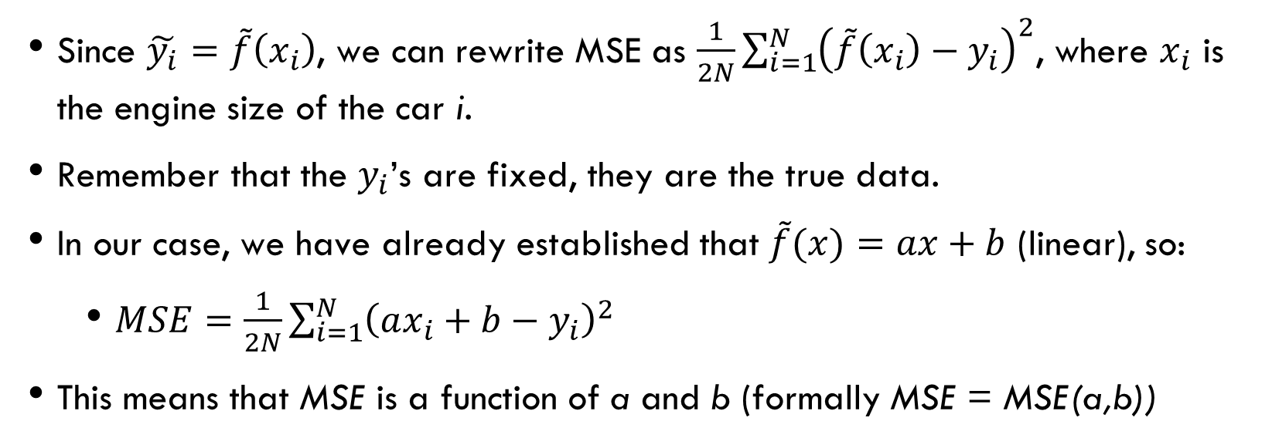
2. Introduction to loss functions
Since $\tilde{y_{i}}=\tilde{f}\left(x_{i}\right)$, we can rewrite MSE as $\frac{1}{2N}\sum_{i=1}^{N}{{\left({\tilde{f}\left(x_{i}\right)−y}_{i}\right)}^{2}}$, where $x_{i}$ is the engine size of the car i.
Remember that the $y_{i}$’s are fixed, they are the true data.
In our case, we have already established that $\tilde{f}(x)=ax+b$ (linear), so:
$MSE=\frac{1}{2N}\sum_{i=1}^{N}{{\left(ax_{i}+b−y_{i}\right)}^{2}}$
This means that MSE is a function of a and b (formally MSE = MSE(a,b))

Slide 9
2. Introduction to loss functions
From now on, we shall call the loss function (which in our case is MSE) L
L need not necessarily be MSE, but it is in our case because «we believe» that it encapsures the error efficiently

Slide 10
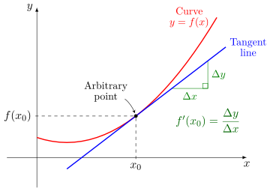
3. Brief calculus recap: derivatives
The derivative of a function with respect to a variable represents the slope of the function at a given point
It’s the slope (inclination) of the line tangent to the function at that point

Slide 11
3. Brief calculus recap: derivatives
They tell the direction of steepest ascent of the function at a given point.
In 1D the directions are left and right
If derivative>0 at a point, the function is increasing, i.e., to maximize it, we must move to the right in the x axis

Slide 12
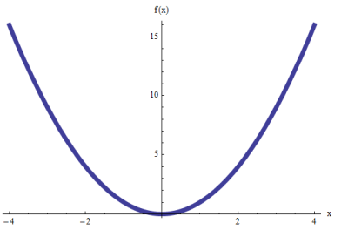


3. Brief calculus recap: derivatives
Small derivative: the function is not very sensitive to a variation of x at that point
Great derivative: the function is very sensitive to a variation of x at that point
Great derivative
Small derivative

Slide 13
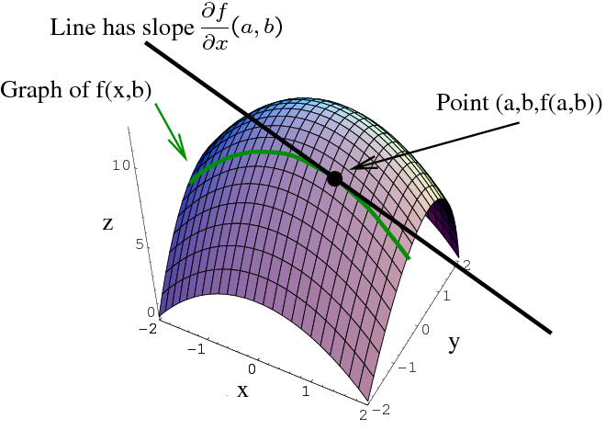
3. Brief calculus recap: Partial derivatives
A partial derivative is just a derivative with respect to one of the variable and keeping all the other variables constant
If it is with respect to x, we fix y and we are allowed to move only left and right at the chosen y (green line)

Slide 14
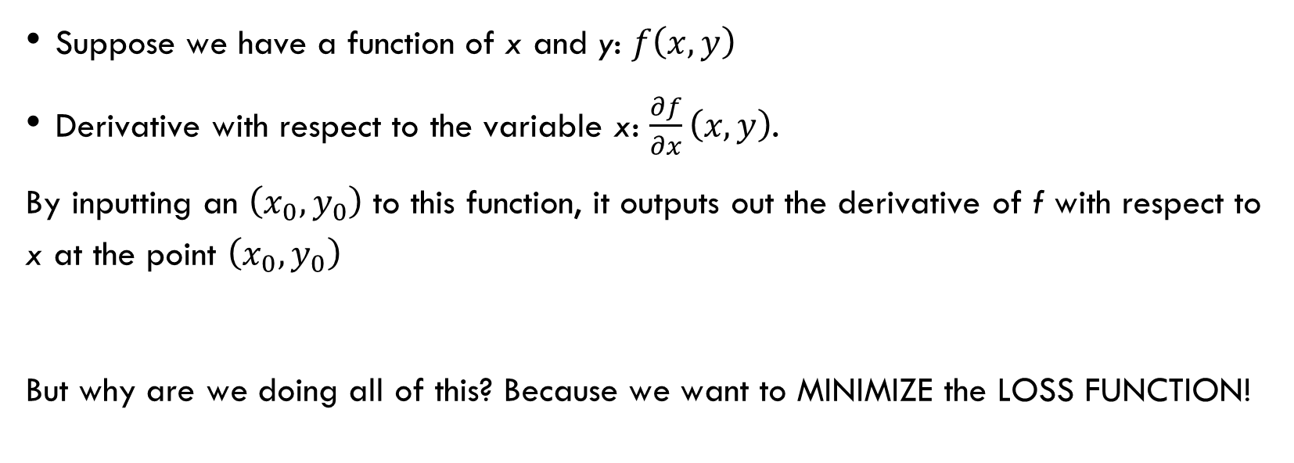
3. Brief calculus recap: Derivatives formalism
Suppose we have a function of x and y: $f\left(x,y\right)$
Derivative with respect to the variable x: $\frac{∂f}{∂x}\left(x,y\right)$.
By inputting an $\left(x_{0},y_{0}\right)$ to this function, it outputs out the derivative of f with respect to x at the point $\left(x_{0},y_{0}\right)$
But why are we doing all of this? Because we want to MINIMIZE the LOSS FUNCTION!

Slide 15
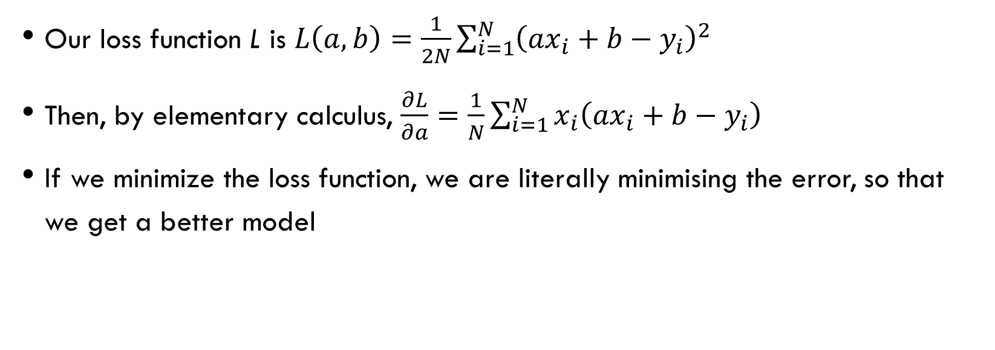
4. Linear regression with gradient descent
Our loss function L is $L\left(a,b\right)=\frac{1}{2N}\sum_{i=1}^{N}{{\left(ax_{i}+b−y_{i}\right)}^{2}}$
Then, by elementary calculus, $\frac{∂L}{∂a}=\frac{1}{N}\sum_{i=1}^{N}{x_{i}\left(ax_{i}+b−y_{i}\right)}$
If we minimize the loss function, we are literally minimising the error, so that we get a better model
Hence why we divide by 2, so that it cancels out with the power during derivation

Slide 16
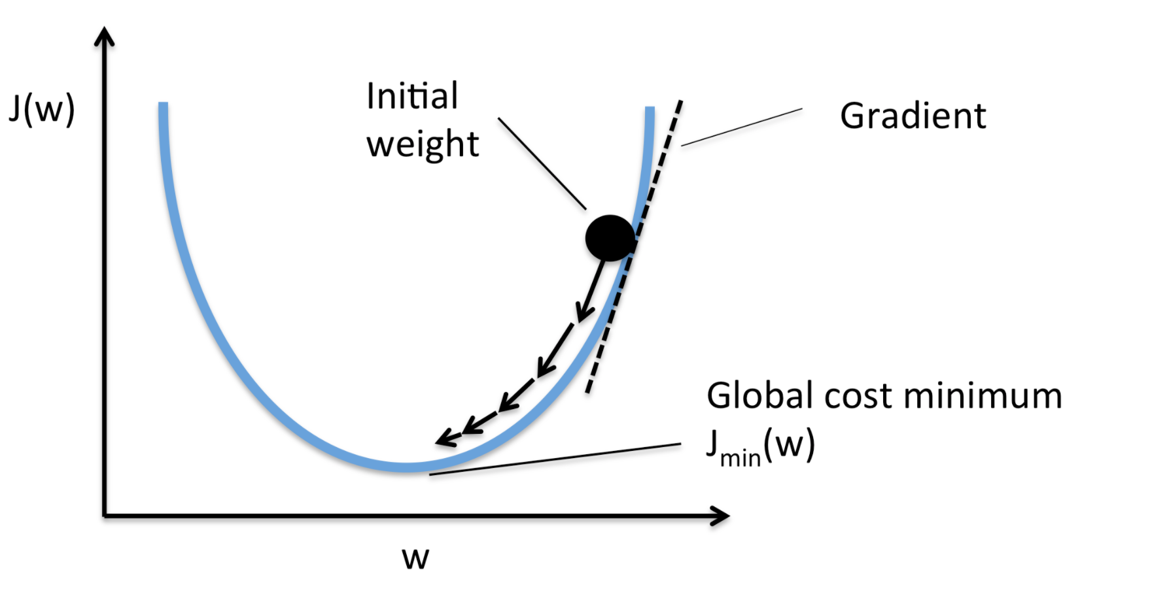

4. Linear regression with gradient descent
We are taking steps towards the minimum “proportional” to the derivative at a specific point
We want to control how big the steps are. Too big: miss the minimum. Too small: don’t reach it or stuck in local minimum

Slide 17
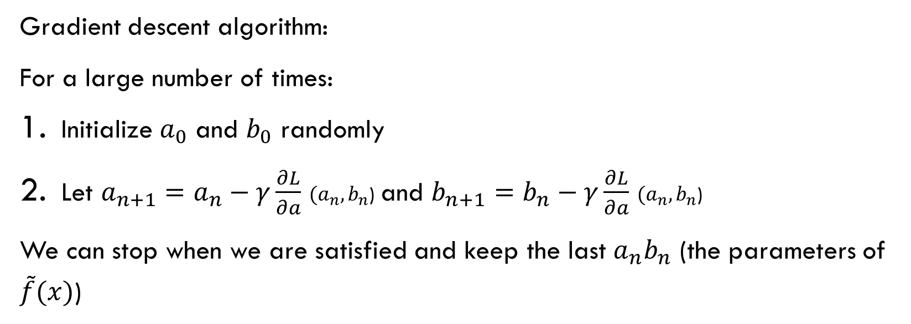
4. Linear regression with gradient descent
Gradient descent algorithm:
For a large number of times:
Initialize $a_{0}$ and $b_{0}$ randomly
Let $a_{n+1}=a_{n}−γ\frac{∂L}{∂a}$ ${(a}_{n},b_{n}$) and $b_{n+1}=b_{n}−γ\frac{∂L}{∂a}$ ${(a}_{n},b_{n}$)
We can stop when we are satisfied and keep the last $a_{n}b_{n}$ (the parameters of $\tilde{f}(x)$)
Learning Rate. The larger, the bigger steps we take toward the minimum

